Slide 1
Creating an ER DIAGRAM
Introduction to Databases

Slide 2
ER Diagram Example
Create an ERD for a Library Management System. The library system stores information on books and its members. The following information is stored on books: isbn, title, author, and an indication as to whether it is available or not. Information on the book publisher is also stored: publisher id, name and address, The membership ID, name, address, contact number and membership date is stored for each member. The library system also keep track of which book are on loan to who, the date they went on loan and return date.

Slide 3
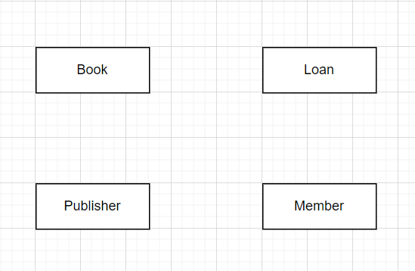
Step 1 – Identify Entities
Create an ERD for a Library Management System. The library system stores information on books and its members. The following information is stored on books: isbn, title, author, and an indication as to whether it is available or not. Information on the book publisher is also stored: publisher id, name and address, The membership ID, name, address, contact number and membership date is stored for each member. The library system also keep track of which book are on loan to who, the date they went on loan and return date.
Entities
Book
Member
Publisher
Loan

Slide 4
Step 2 – identify Attributes & Relationships
Attributes
Book: isbn, title, author, available
Member: membershipID, membershipDate, contatcNumber, address, name (first name and surname)
Publisher: publisherID, name and address
Loan: loanID, loanDate and returnDate
Remember to identify primary key attributes.
Relationships
One Publisher publishes Many Books
One Member borrows Many Loans
Many Books are loaned through Many Loans

Slide 5
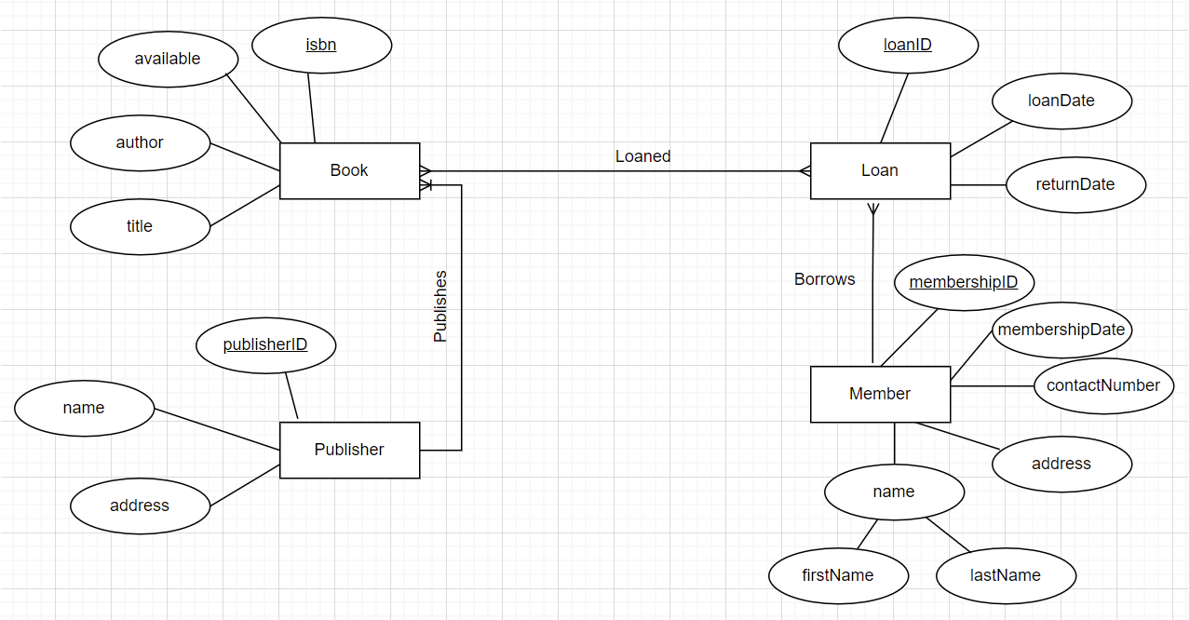

Slide 6
Step 3: Converting Entities into relations
An entity is turned into a table.
Each attribute turns into a column in a table.
The key attribute of the entity is the primary key in the table.
A multivalued attribute is turned into a new table, and One to Many relationship is defined between this new table and the existing one.
A One to One relationships requires two tables, the primary key from either table can be used as a foreign key in the other.
A One to Many or Many to One relationships require two tables, the primary key from the table on the ‘One’ side is used as a foreign key in the table on the ‘Many’ side.
Many to Many relationships require three tables, the primary keys from both original table will appear as foreign keys in the new table.

Slide 7
